Slide 1
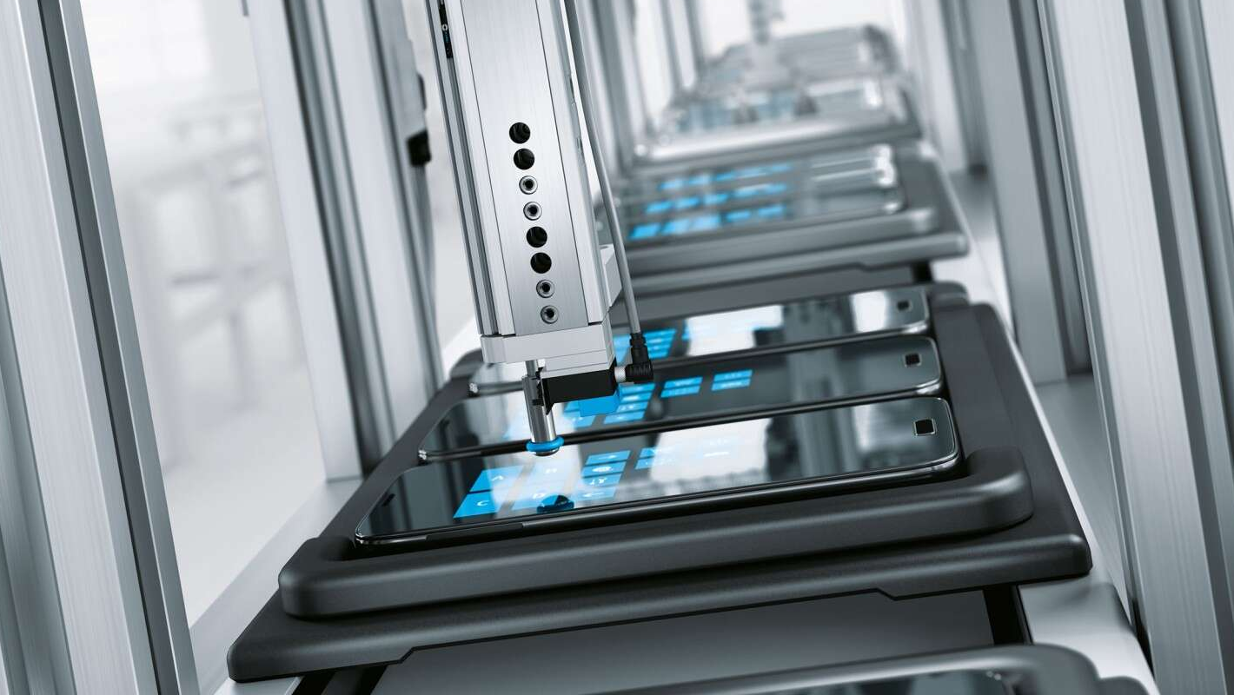
Conveyor Systems in Smartphone Manufacturing Process
Presentation in Basic Mechanical Engineering

Slide 2

How a Smartphone is Made

Slide 3
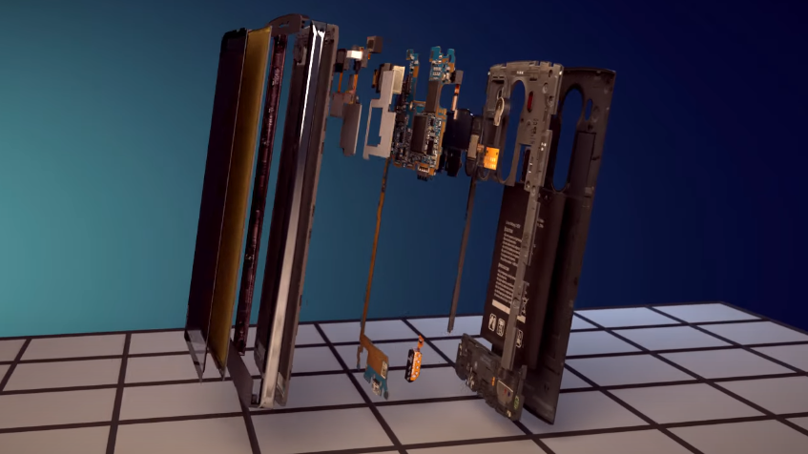
The Inside of a Smartphone

Slide 4
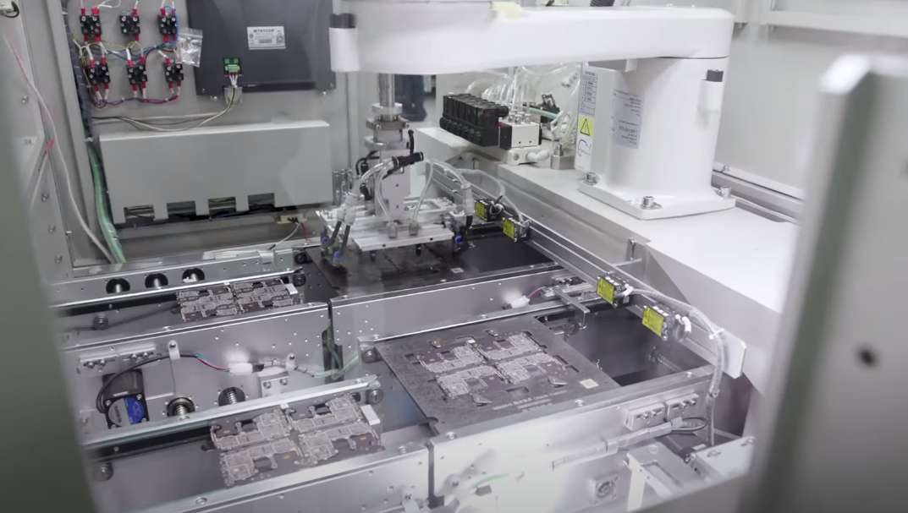
A Robotic Arm usually does most of the technical work of Manufacture

Slide 5
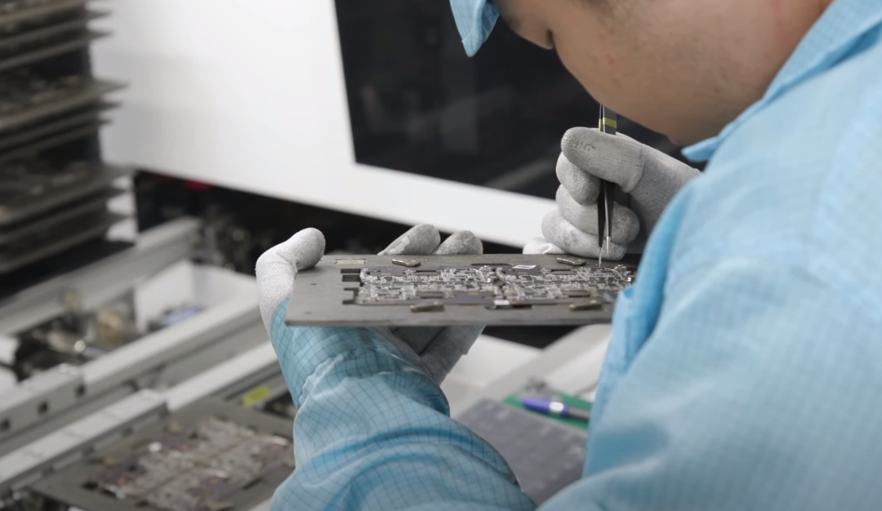
Every Step is followed by an inspection process

Slide 6
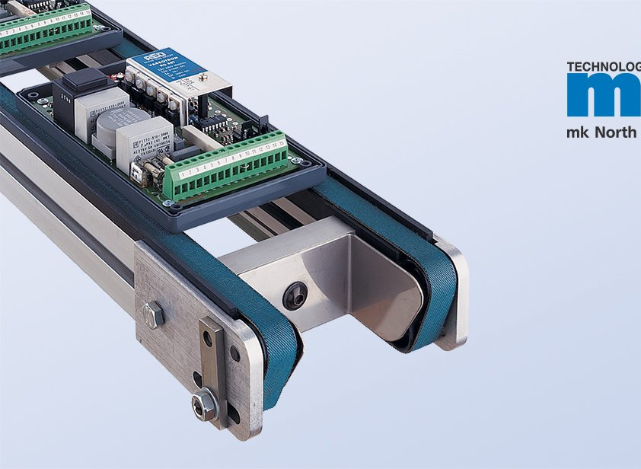
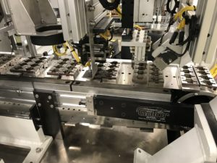
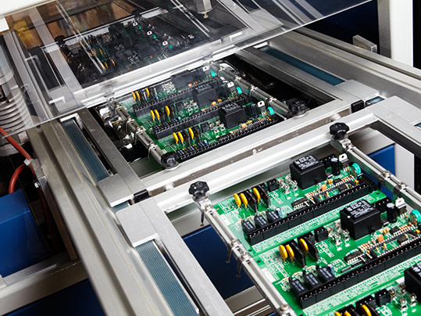
Electronics are transported by motor controlled conveyors

Slide 7
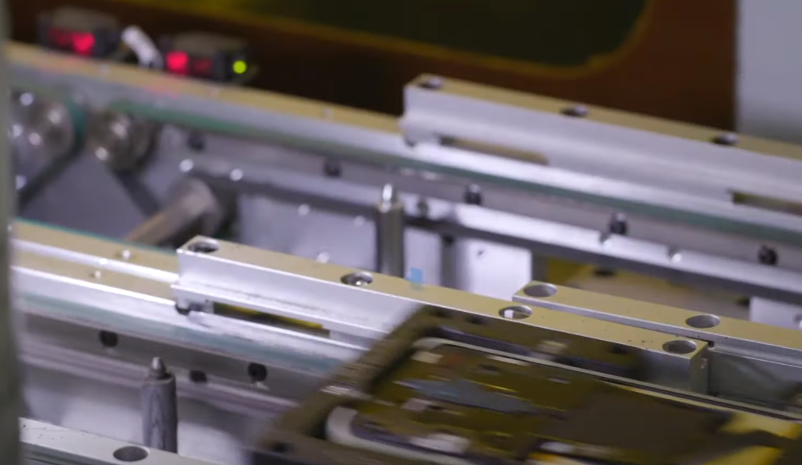
Moved With Motors and shafts

Slide 8
Advantages
The right conveyor control saves time, money and efficiency. It will optimize your material handling systems and warehouse operations.
It will allow for variable production rates and quick production changes. Programmable Logic Controls (PLC) allow for this necessary direct system control.
This centralized network-oriented approach is best primed for automation and attaining the numbers you need to thrive.

Slide 9
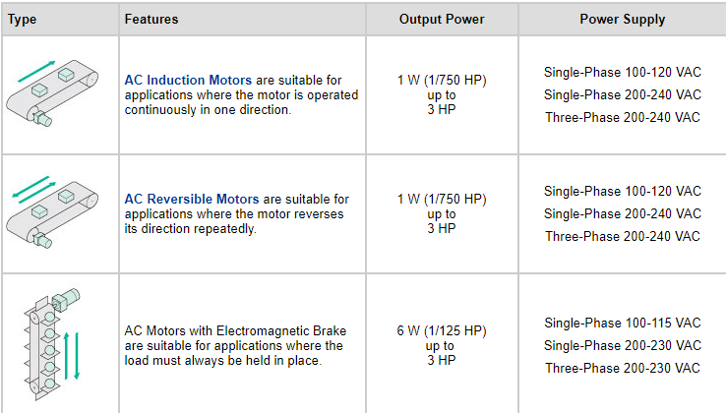

Slide 10
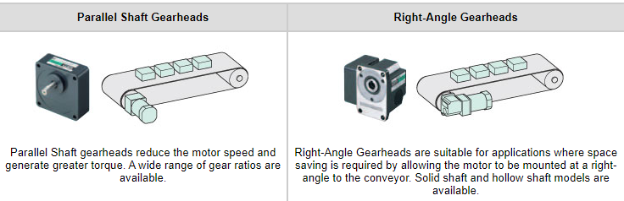

Slide 11
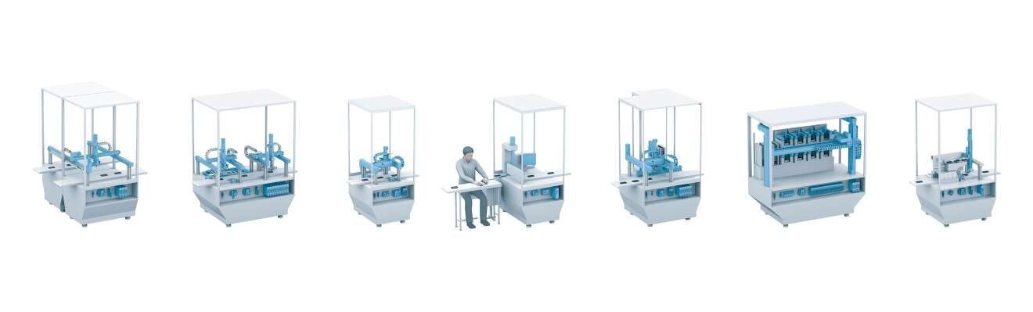

Slide 12
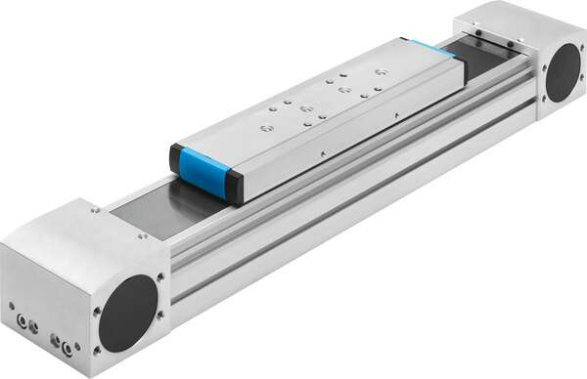
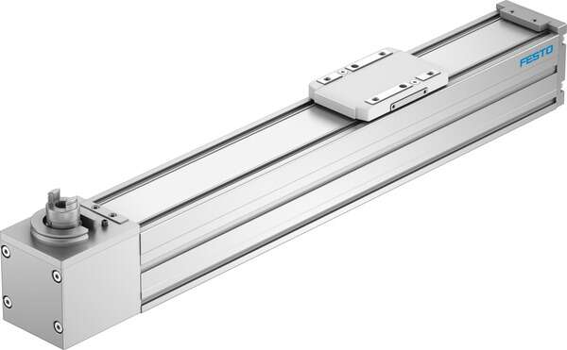
Conveyors used in Phone Manufacturing

Slide 13
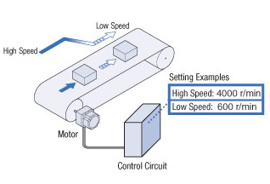

Slide 14
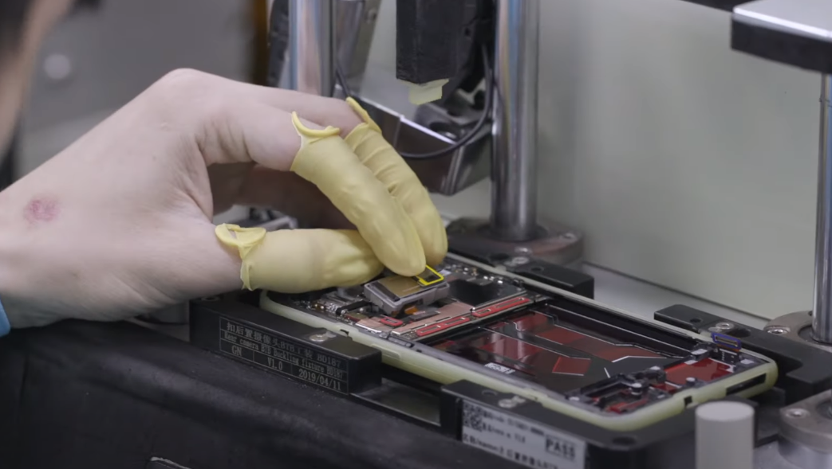
Attaching Camera Module

Slide 15
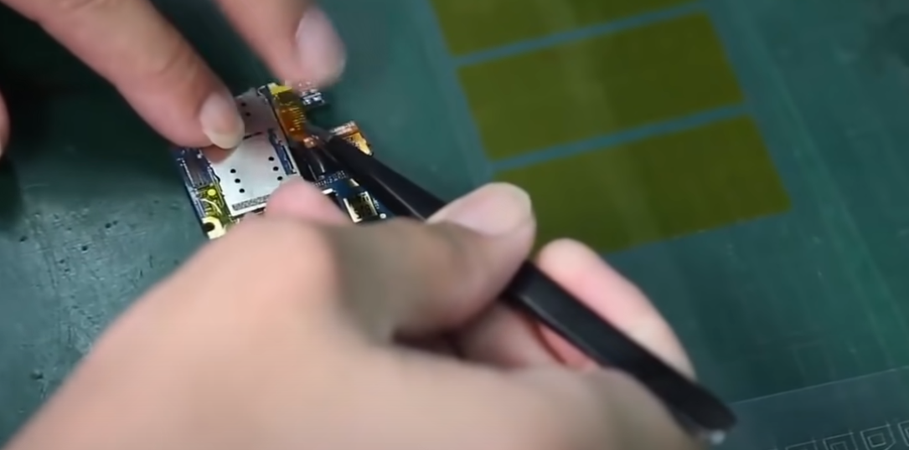

Slide 16
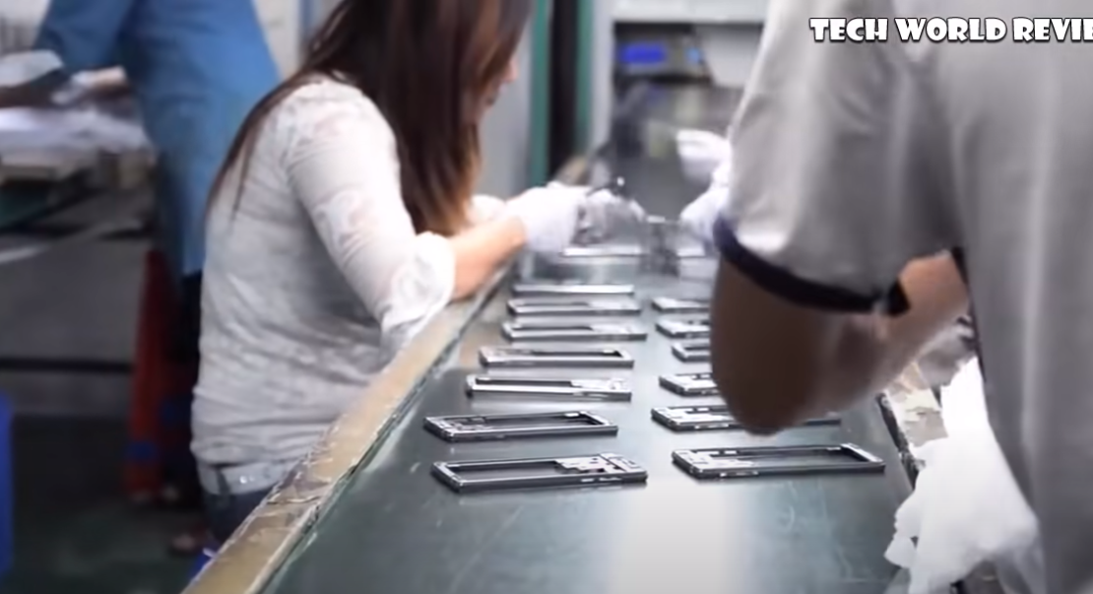
For parts, Belt conveyers are used

Slide 17
Advantages and Disadvantages of belt conveyers
Belt Conveyor System
Advantages
One of the cheapest conveyors
Simple and easy to use
Can have changes in elevation
Can be loaded from any place along the belt
Disadvantages
The simplicity means very limited features
Belt can be difficult to clean and generally does not leave a very successful result
Sticky material can get stuck on the belt and transfer to the return side, the rolls, idlers and pulleys

Slide 18
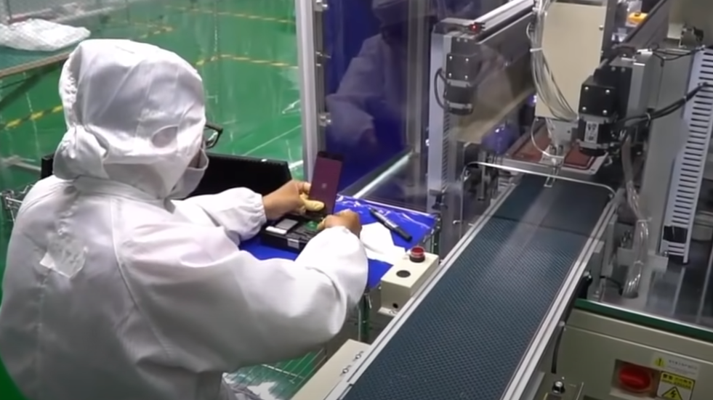
Belt conveyors are used also for manual checks by workers to pass to special machines

Slide 19
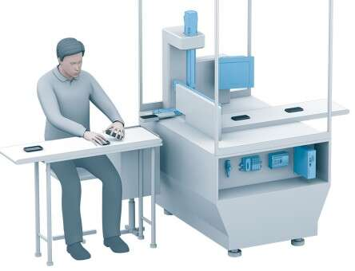

Slide 20
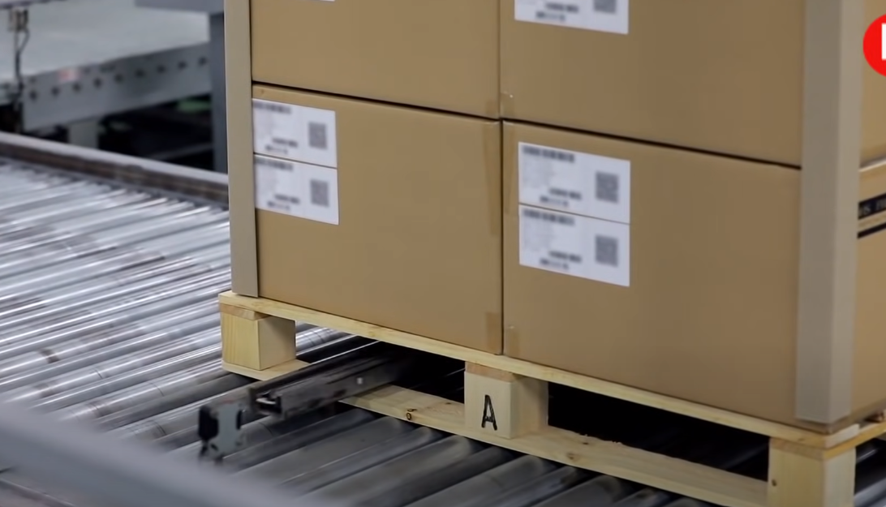
For Finished Products, rollers are used at the end

Slide 21
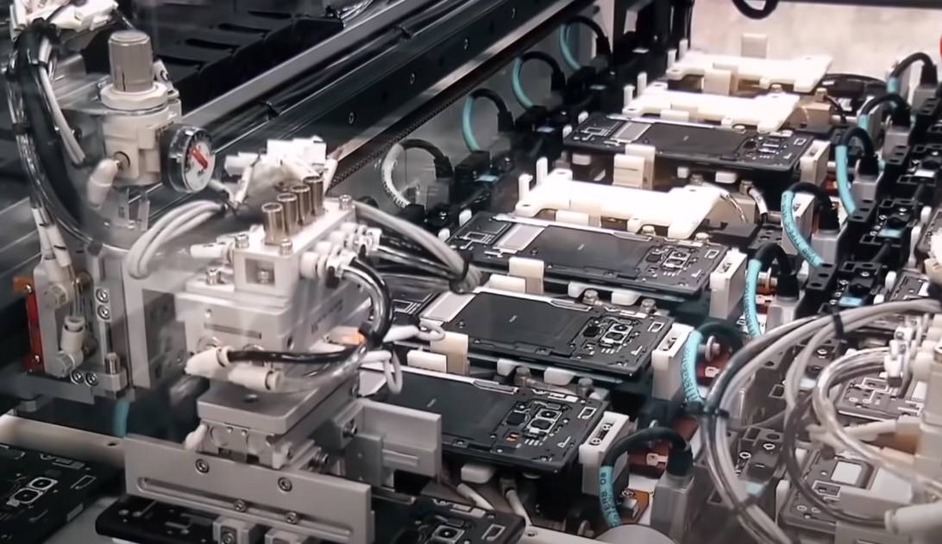
For Phones, Robotic Arms are used

Slide 22
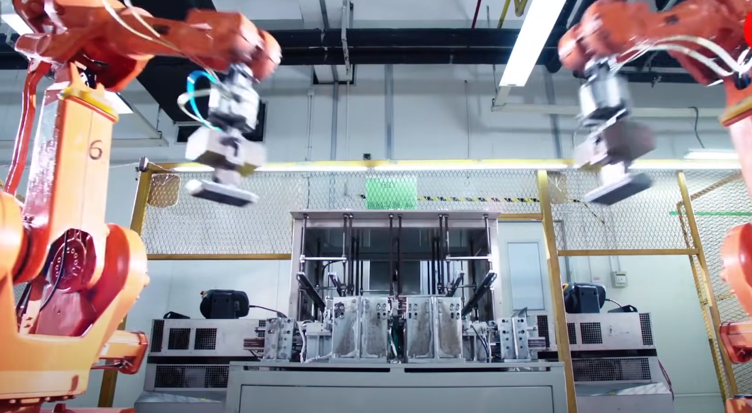

Slide 23
Testing is finally done by robots

Slide 24
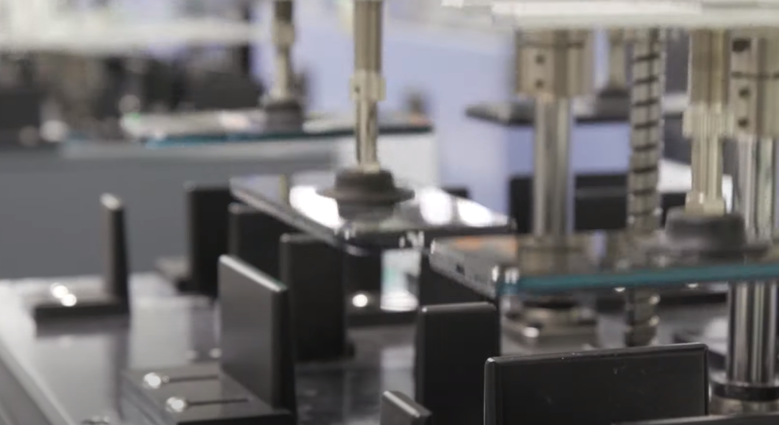
Drop Testing

Slide 25
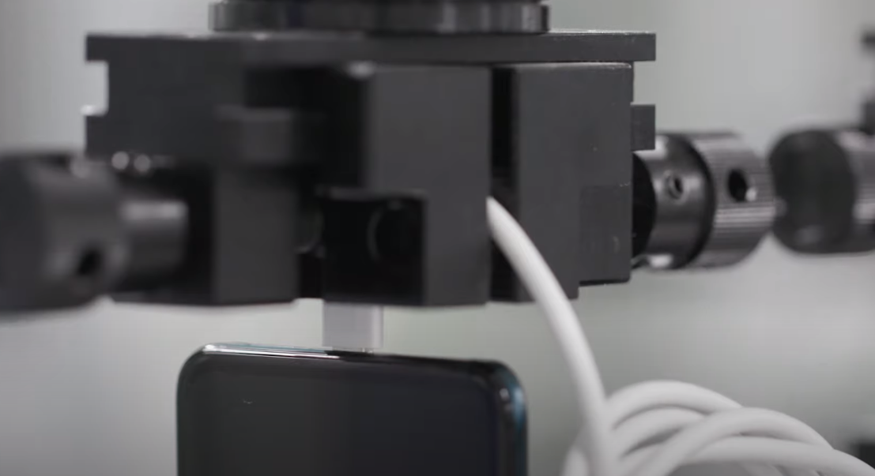
Jack Testing

Slide 26
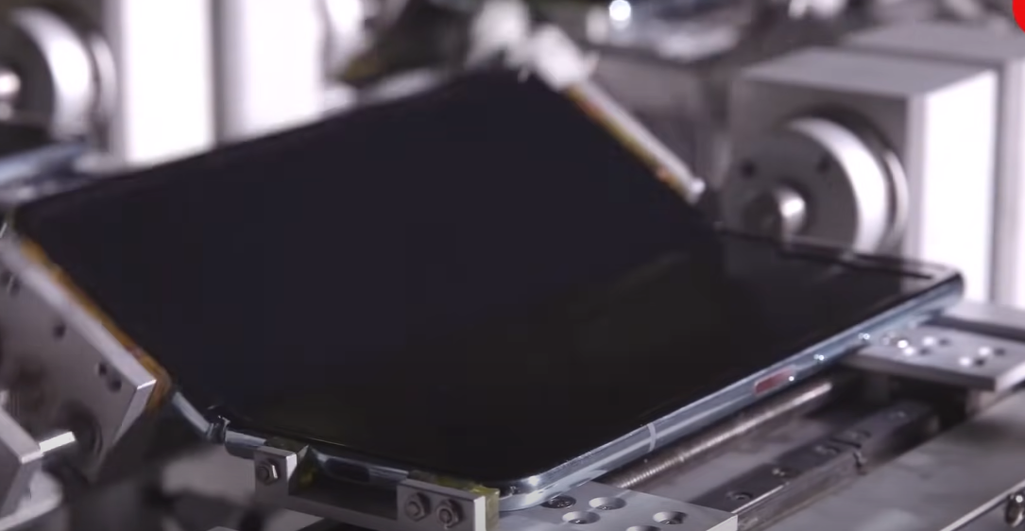
Fold Testing

Slide 27

Thanks!

